Slide 1
Natural Language Processing using Deep Learning

Slide 2
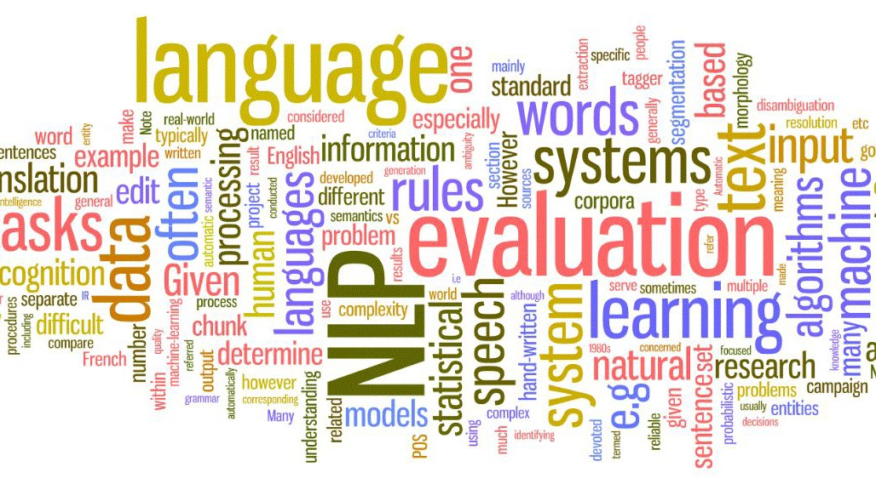
What Have You Learned?
Working with text data

Slide 3
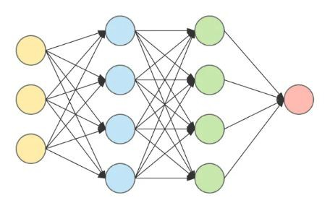
What Have You Learned?
Working with text data
Deep learning concepts and model architectures

Slide 4

What Have You Learned?
Working with text data
Deep learning concepts and model architectures
Building deep learning models using PyTorch

Slide 5
Why Deep Learning for NLP?
In traditional NLP, text can be represented as a single vector
that place is incredible
vector representation

Slide 6
Why Deep Learning for NLP?
In traditional NLP, text can be represented as a single vector
Frequency based techniques: Bag-of-Words and TF-IDF
that place is incredible
vector representation

Slide 7
Why Deep Learning for NLP?
In traditional NLP, text can be represented as a single vector
Frequency based techniques: Bag-of-Words and TF-IDF
Contextual Embeddings: word2vec
that place is incredible
vector representation

Slide 8

Why Deep Learning for NLP?
In traditional NLP, text can be represented as a single vector
Frequency based techniques: Bag-of-Words and TF-IDF
Contextual Embeddings: word2vec
Traditional methods do not eﬃciently capture the sequential information

Slide 9
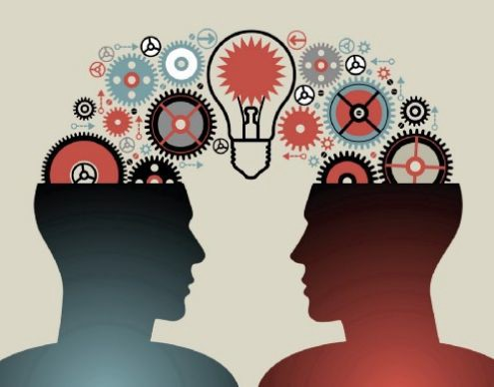
Why Deep Learning for NLP?
In traditional NLP, text can be represented as a single vector
Frequency based techniques: Bag-of-Words and TF-IDF
Contextual Embeddings: word2vec
Traditional methods do not eﬃciently capture the sequential information
In deep learning, we can leverage transfer learning for NLP
Pre-trained transformer models

Slide 10
Thank You

